Slide 1

Analysing the Impact of Car Features on Price and Profitability

Slide 2
Excel Project link below:
https://docs.google.com/spreadsheets/d/1hizedm-BHiH2FQUlxHJqHf6Qd-cZjhIj/edit?usp=drive_link&ouid=101202744784682762684&rtpof=true&sd=true

Slide 3
PROJECT DETAILS:
This project explores a car dataset to reveal insights and address key business questions in the automotive industry. The dataset includes diverse information such as car details, engine specs, fuel efficiency, and pricing. The main goal is to understand factors impacting car pricing and fuel efficiency.
We analyze car price distribution across brands and body styles, examining how transmission type and body style impact suggested retail prices. Fuel efficiency trends are explored across body styles and model years, while the relationship between car brands and attributes like horsepower, MPG, and price is visualized in a bubble chart for easy comparison.
We cleaned and prepared the data carefully to make sure it's accurate. We fixed missing information, removed duplicates, and made everything consistent. We assumed the data represents different types of cars in the market and that it's accurate. These assumptions help us find meaningful insights and make recommendations based on our analysis.
The goal of this project is to offer useful insights and practical information to people in the car industry. This will help them make informed decisions about pricing, features, and fuel efficiency improvements.

Slide 4

My Approach for analysis:
In our project, we applied descriptive statistics, visualization methods, and modeling to examine the car dataset and tackle business inquiries. Descriptive statistics were employed to summarize data and provide insights into various car attributes.
Visualization techniques, including pivot tables, charts, and plots, were utilized to present data visually and identify patterns and trends.
Additionally, regression analysis was conducted to pinpoint the crucial variables influencing car prices.
Tech-Stack Used: Microsoft Excel 2021

Slide 5
TASK 1: How does the popularity of a car model vary across different market categories?
n this task, we consolidated market categories by grouping similar ones together to simplify the chart. For instance, combining "Crossover, Diesel" and "Crossover, Flex Fuel" into a broader category called "Crossover - Fuel Type" or "Crossover - Diesel/Flex Fuel." This approach allows for the consolidation of other market categories based on similarities
The category "Crossover-Fuel Type" boasts the highest number of car models and enjoys significant popularity.
"Factory Tuner, Performance" and "Exotic-Performance" are market categories that require improvement.

Slide 6
TASK 2: What is the relationship between a car's engine power and its price?
When visualizing the data points on a scatter chart, we can observe the overall pattern or trend between engine power and price.
The trendline indicates a positive correlation, showing how engine power and price are related.
The equation y = 365.29x - 50551 suggests a positive linear relationship, and the R² value of 0.4383 means that about 43.83% of the variability in price can be explained by engine horsepower.
The correlation coefficient of 0.66 suggests a moderate positive relationship, meaning that as engine horsepower increases, there is a tendency for the car price to increase as well.

Slide 7
TASK 3: Which car features are most important in determining a car's price?
Regression analysis helps us understand how car features impact the price. Using coefficient values, we assess the influence of variables.
A rank system is used for Vehicle Style and Transmission Type.
The analysis highlights positive impacts from variables like Engine HP and Engine Cylinders, and negative impacts from variables like Number of Doors, highway MPG, city MPG, Transmission Type, and Vehicle Size.

Slide 8
TASK 4: How does the average price of a car vary across different manufacturers?
Task 4.A involved creating a pivot table to find average car prices by manufacturer, providing a comprehensive overview.
In Task 4.B, a bar chart visually represented the relationship between manufacturers and average prices, highlighting variations across the industry.
Results showed a wide range of prices, with luxury brands commanding higher prices than mainstream ones like Honda and Toyota.

Slide 9
TASK 5: What is the relationship between fuel efficiency and the number of cylinders in a car's engine?
Task 5.A created a scatter plot showing a negative relationship between the number of cylinders and highway MPG, indicating that as cylinders decrease, fuel efficiency tends to decrease.
This insight is valuable for decisions related to vehicle efficiency and environmental considerations.
In Task 5.B, the correlation coefficient of -0.62 quantifies the moderate inverse relationship between the number of cylinders and highway MPG, emphasizing the connection between fewer cylinders and higher fuel efficiency.

Slide 10
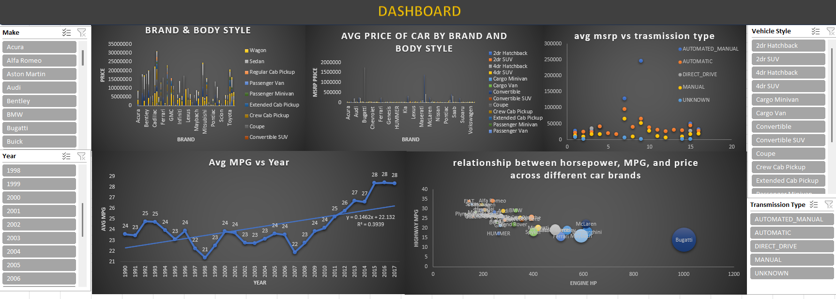
TASK 6: Building the Dashboard:

Slide 11
Excel Project link below:
https://docs.google.com/spreadsheets/d/1hizedm-BHiH2FQUlxHJqHf6Qd-cZjhIj/edit?usp=drive_link&ouid=101202744784682762684&rtpof=true&sd=true

